Slide 1
PayTrack Insights Intelligent Payment Failure Analytics
Aravind Palani – 7639 (Developer) Guna Teja Yadavalli – 12024 (Developer) Tamilarasan Ganesan – 11320 (Developer) Date : 03-07-2023

Slide 2
Agenda
Problem Statement & Impact
Solution Proposed vs Solutions Available in Market
Key Metrics, Unique Value Proposition, Unfair Advantage
Proof of Concept Demo, Technologies Used
Future Roadmap

Slide 3
Problem Statement
Payment failures pose a significant challenge in the realm of online shopping and hotel reservations. These failures not only lead to user frustration but also result in missed business opportunities for platform owners.
Furthermore, identifying the specific reasons for these failures, especially in cases of system malfunctions, can be a complex and challenging task.

Slide 4
Impact of the Problem
User Dissatisfaction : Payment failures can lead to user frustration and dissatisfaction. Customers who experience payment issues may abandon their purchase or booking altogether, resulting in lost sales and potential long-term customer dissatisfaction.
Revenue Loss: Payment failures directly impact the revenue of platform owners. Failed transactions mean missed business opportunities, as customers are unable to complete their purchases or bookings. This loss of revenue can have a significant impact on the overall financial health and growth potential of the platform.
Damage to Reputation: Frequent payment failures can damage the reputation of the platform among users. Negative experiences and difficulties in completing transactions can lead to a loss of trust and confidence in the platform's reliability, which can deter potential customers from using the service in the future.

Slide 5
Solution Proposed by You
Our application efficiently analyzes transaction failures and categorizes them into specific buckets.
We collect failure-related details from multiple sources such as logs, database and real-time API inputs via Logstash and filter out necessary information using techniques like pattern matching.
The information is then processed by an ML model trained to understand failure reasons and assign them to appropriate buckets.
Our application will also notify the users with a personalized email templates with the possible reason of failure as per the bucket predicted by ML model. This feature helps users understand the reasons behind failures, especially if they are related to user issues like incorrect card numbers or insufficient funds and encourage them to re-initiate the transaction correcting the failure reason.
We also introduced a user interface that shows the failure statistics in dashboards and had more features such as report generation, customizing email templates, and the ability to create new buckets.

Slide 6
Solutions Available in Market Already
Advanced Machine Learning: Existing market solutions often lack advanced machine learning capabilities for failure analysis, whereas our solution leverages ML models to provide more accurate and automated identification of failure reasons.
Custom Email Notifications: Unlike other solutions, our solution offers the ability to create personalized email notifications for failed transactions, enhancing communication and enabling users to take appropriate actions.
Comprehensive Data Analysis: Our solution stands out by employing a comprehensive approach to data analysis, collecting and analyzing transaction failure-related details from multiple sources, providing a holistic view of failures for thorough analysis. Ex : Splunk, Kibana, AppDynamics, New Relic

Slide 7
Key Metrics
Implement data collection mechanisms from logs, database tables, and real-time API inputs, ensuring the capture of relevant transaction failure-related details.
Train the ML model using a comprehensive dataset to accurately understand the reasons behind transaction failures and categorize them into defined buckets with a high degree of accuracy.
Integrate the feature that allows users to create personalized email templates for sending notifications about failed transactions within specific buckets, ensuring it is user-friendly and easily configurable.
Implementing a user interface (UI) that includes interactive dashboards showcasing failure statistics under each bucket and provides users with the ability to download reports

Slide 8
Unique Value Proposition
Advanced Machine Learning: Our solution utilizes advanced machine learning techniques for precise analysis and categorization of transaction failures, providing accurate insights for resolution.
Comprehensive Data Collection: We employ a comprehensive approach to gather transaction failure-related details from multiple sources, ensuring a thorough analysis and a holistic view of failures.
Personalized Email Templates: Our solution introduces a unique feature that allows users to create personalized email templates for sending notifications about failed transactions within specific buckets, enhancing communication and user comprehension.
User-Friendly UI with Dashboards: Our user interface (UI) features interactive dashboards showcasing failure statistics under each bucket, providing a visual representation of failure trends for quick analysis.
Downloadable Reports: Our solution offers the ability to download reports, enabling users to access comprehensive documentation of transaction failures, analysis results, and insights for further review and sharing.

Slide 9
Unfair Advantage
Deep Domain Expertise: Our extensive domain expertise in transaction failure analysis allows us to offer a tailored solution that addresses specific challenges, setting us apart from generic offerings.
Proprietary Technology: We leverage proprietary technology and algorithms, which cannot be easily replicated or acquired, giving us a unique selling proposition and a competitive edge.
Existing Partnership and Integration Capabilities: Our established partnerships and seamless integration with customers' systems provide us with an advantage, as we have a deeper understanding of their operations and can offer a more streamlined implementation process compared to competitors.

Slide 10
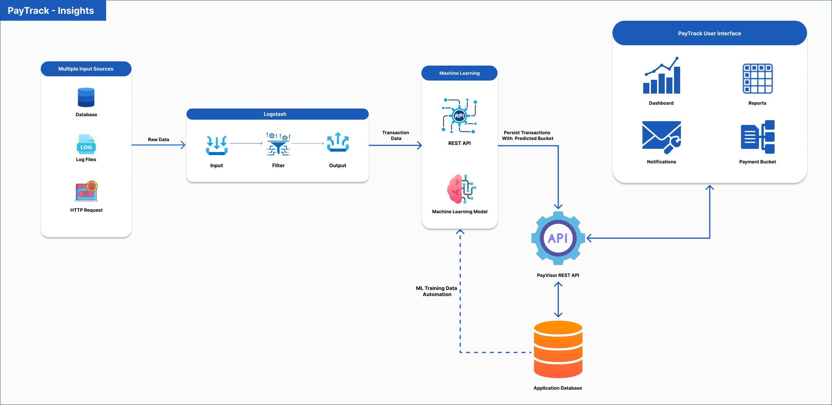
System Diagram

Slide 11
Proof of Concept (PoC)
DEMO

Slide 12
Technologies Used
APIs - Java, Spring Boot (Spring Data JPA, Spring Data Rest, Spring Mail), SQL, Apache POI for Excel
Logstash - JRuby
ML – Python, Scikit-learn, Pandas
UI – ReactJS, MUI
Database - MySQL
Cloud/Deployment - AWS (EC2, Elastic Beanstalk, S3, RDS-MySQL)

Slide 13
Solution Roadmap Beyond PoC
Data Security
Scheduling Reports
Week 2
Week 3
Improvising ML Model
Week 5
Creating Alerts
Week 4
Week 6
Custamizable Dashboard & Charts

Slide 14
Customer Segments
A financial institution, e-commerce shopping company, or an online hotel reservation platform, along with other marketplaces that facilitate online money transactions (such as PayPal, eBay, and Airbnb), would be potential customers for this product. These entities handle substantial transaction volumes on a daily basis and often encounter transaction failures, which makes them ideal candidates to benefit from our solution.

Slide 15
Other Important Aspects
Data Security: Robust measures are in place to ensure the confidentiality, integrity, and availability of sensitive transaction-related information.
Scalability and Performance: The solution can seamlessly handle increasing transaction volumes while maintaining optimal performance.
Integration Flexibility: The solution easily integrates with existing systems, platforms, and APIs, minimizing disruption during implementation.
Real-time Monitoring and Alerts: The solution provides real-time monitoring of transaction failures, accompanied by automated alerts and notifications for swift issue resolution.

Slide 16
Keep Innovating

